Slide 1
A Cellular Automata Model for Target Tracking in Distributed Mobile Wireless Sensor Network
Islamic University of Technology(IUT) Department of Computer Science and Engineering(CSE)
Supervisor:
Md. Sakhawat Hossen
Assistant Professor,Department of CSE
Islamic University of Technology (IUT)
Presented By:
Shahidullah Kaiser(134420)
Rahat Hussein Khan(134426)

Slide 2
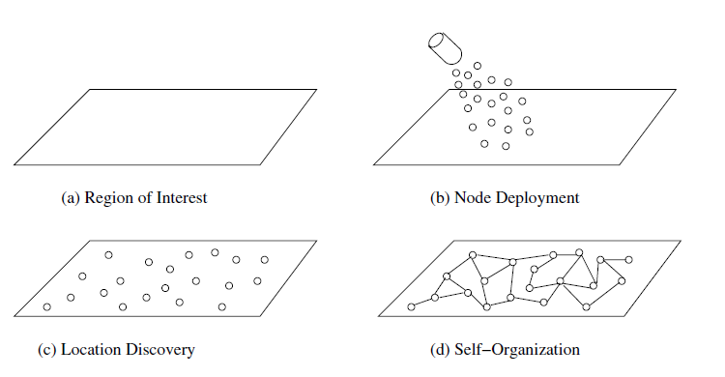
Introduction
Mobile Wireless Sensor Network (MWSN)
distributed sensing and processing capabilities
Basically a wireless sensor network (WSN) in which the sensor nodes are mobile.
Consists of several tiny mobile nodes.
limited attributes energy, transmission range, memory, processing power.
More versatile than static sensor networks
Figure taken from [1]

Slide 3
Limitations of Mobile Wireless Sensor Network
Energy of the nodes are limited
Small sensing and communicating region for each node
Movement limited due to small amount of energy
Requires high degree of cooperation among the nodes

Slide 4
Objectives
Track a moving target considering energy-efficiency.
Increasing lifetime of the network .
Finding the optimum coverage with minimum movement of the nodes.
Therefore, the final objective is to track a target by balancing among:
Network coverage,
Network connectivity, and
Network lifetime

Slide 5
Target Tracking in MWSN
Detect an object in the network area.
Track the moving path of the object.
Initially Deploy the sensor to cover an Area.
Energy-efficiency is one of the significant issues.
Challenge is to combine between coverage and Lifetime of the Network.

Slide 6
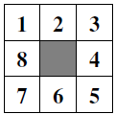

Related Work (1/7)
Simulating large Wireless Sensor Networks Using Cellular Automata, IEEE Annual Simulation Symposium, 2005 (CUNHA)
Verifies the applicability of using Cellular Automata(CA) for simulating different aspects of sensor networks
CA defined formally as a 4-tuple $(L, S, N, f)$
$L$ – A regular grid of cells
$S$ – A finite set of states for each cell
$N$ – Finite set on neighborhood indices
$f$ – Transition function
Figure taken from [1]

Slide 7
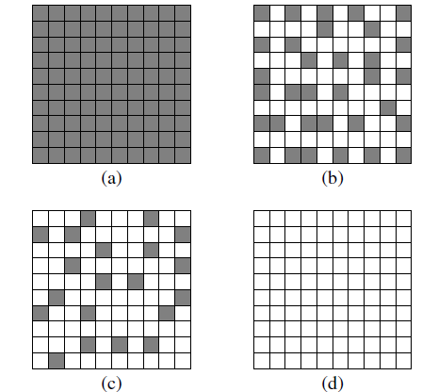
Related Work Contd. (2/7)
Applies the Topology Control Algorithm:
Grey cells in (a) show that all nodes are in ‘on’ state
Algorithm used to turn certain nodes ‘off’ while
maintaining connection within the network
Network dies when the energy of all nodes are drained
Figure taken from[1]

Slide 8
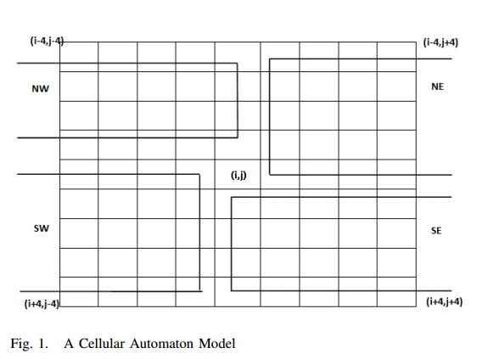
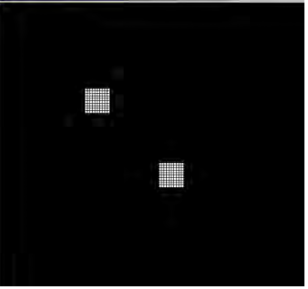
Related Work Contd. (3/7)
Energy Efficient Cellular Automaton Based Algorithms for Mobile Wireless Sensor Networks, 2012 IEEE Wireless Communications and Networking Conference.
to position the sensors in a way that maximizes the coverage.
to minimize the movements of the sensors
In a reasonable amount of time.
Figure taken from [3]
Figure taken from [3]

Slide 9
Related Work Contd. (4/7)
A Cellular Automaton Model for Wireless Sensor Networks(JCA):
Cellular automaton algorithms to optimize the coverage and the lifetime of a WSN.
For Coverage uses radius-1 or radius-2 neighborhood (CUNHA).
Each cell can have 3 states: awake, asleep and dead.
A cell in the awake state that has at least i neighbors awake, goes to the asleep stale; otherwise it remains awake.
A cell in the asleep state that has less then j neighbors awake, wakes up; otherwise it stays asleep.
CA model also can detect objects .

Slide 10
Related Work Contd. (5/7)
Localized Motion Planning algorithm for Mobile Wireless Sensor Networks, Int. Journ. of Unconventional Computing.
Develops a set of CA-based algorithms for movement of sensors in MWSNs in a Hexagonal grid
Sensors initially deployed at the center of the environment
Sensors spread out using the introduced algorithms to increase coverage
Maintains connectivity during movement

Slide 11
Related Work Contd. (6/7)
A CA Model for Target Tracking in Distributed Mobile Wireless Sensor Network.
Evaluating the proposed model: lifetime, coverage and tracking quality.
Consider different Cell States: Existence, Activity, Alerting and Energy
For movement Neighbor Count algorithm is used.
Determines the movement of the sensors based only on a numerical quantity obtained by counting the numbers of nearby sensors.
Given two thresholds k1, k2 where k1 < k2, a sensor does not move if k1 ≤ n ≤ k2, where n is the number of sensors located within Rc from the cell

Slide 12
Related Work Contd. (7/7)
For Energy Efficiency Activation Strategy is followed:
If a sensor in the active state has more than n1 active neighbors, then it should move into the stand-by state;
If a sensor in the stand-by state has less than n2 active neighbors, then it should move into the active state
For Detection Tri-level alerting system is followed:
Different Alerting state detect the presence of target

Slide 13
Selective and Duty Cycled Activation Strategy
Small subset of all the nodes are in tracking mode at any given point of time.
The entire sensor network periodically turns off and on with a regular duty cycle.
duty-cycled activation can be used in conjunction with any other activation strategy for target tracking

Slide 14
Problem Definition
To Develop a CA-based algorithm for movement of sensors in a MWSN of hexagonal grids to track the object of interest.
Combining Duty Cycled and Selective Activation Strategy for target tracking in order to save more energy.
To develop additional rules to track the target while maintaining balance between coverage and Energy Consumption.

Slide 15
Proposal
Target Tracking using CA has been done in Square Grid using Neighbor Count Algorithm [4].
Motion Planning Algorithm using Hexagonal grid has been implemented in [2]. Coverage has been increased using different Movement Algorithm.
Will implement Hexagonal grid for Sensor Movement Using the Algorithm from [2] in order to maximize coverage.
Combine Selective and Duty Cycled activation strategy to save more energy while tracking.

Slide 16
Reference
[1] Cunha, A. P. Silva, A. A. F. Loureiro, and L. B. Ruiz. Simulating large Wireless Sensor Networks Using Cellular Automata. In Proceedings of the 38th annual Symposium on Simulation, pages 323–330, 2005.
[2] Salimur Choudhury, Sakhawat Hossen, Muhammad Mahbub Alam, Ahnaf Munir, Shihab Uzzaman. Localized Motion Planning algorithm for Mobile Wireless Sensor Networks, Int. Journ. of Unconventional Computing
[3] S. Choudhury, S. G. Akl, and K. Salomaa. Energy efficient cellular automaton based algorithms for mobile wireless sensor networks. In Proceedings of the 2012 IEEE Wireless Communications and Networking Conference, WCNC’12, pages 2341–2346, 2012.
[4] Sang-Ki Ko, Hwee Kim and Yo-Sub Han. A CA Model for Target Tracking in Distributed Mobile Wireless Sensor Network, 13th International Conference on Control, Automations and Systems, (ICCAS), 2013
[5] S. Choudhury, K. Salomaa, and S. G. Akl. A cellular automaton model for wireless sensor networks. Journal of Celluar Automata, 7(3):223–241, 2012.

Slide 17
Thank You

